Slide 1
SCSIT
V Semester
DataBases 2
Lab. Exercise No. 3
Views
System Tables

Slide 2
Create a Database
CREATE DATABASE
Only system administrator has authorization to
execute a CREATE DATABASE command.
CREATE DATABASE <datebase_name>

Slide 3
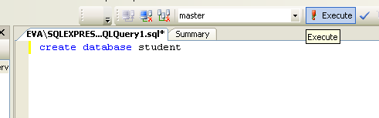

CREATE DATABASE
Press EXECUTE

Slide 4
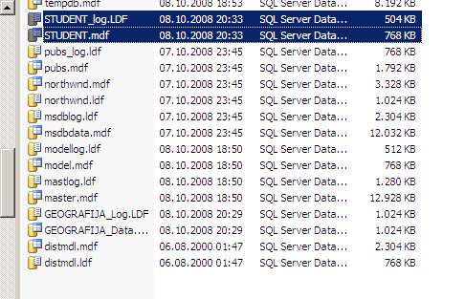
Where are Data Base Files?
Student.mdf
Student_log.LDF
Default location:
C:\Program Files\Microsoft SQL Server\MSSQL.1\MSSQL\DATA

Slide 5
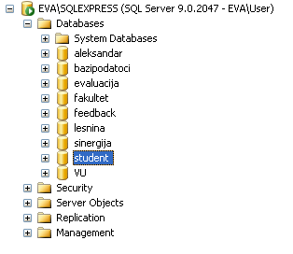
Where is Student DB in
Management Studio structure?

Slide 6
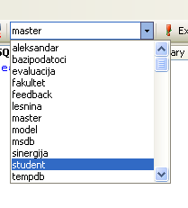
Choose DB to work with (1)

Slide 7
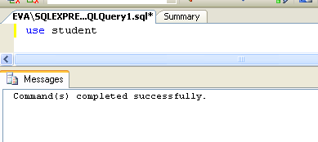
Choose DB to work with (1)
USE <database_name> + Execute

Slide 8
Create Table
CREATE TABLE table_name (
<colum_name 1> <data_type 1>
<colum_name 2> <data_type 2>
…
)

Slide 9
TABLE CREATION I
Tables organization’s data.
Four pieces of information must be
determined:
  Table name
  The column (field) names
  Column data types and
  Column sizes

Slide 10
CREATE TABLE
Create table that stores 6 information about some student
  Table name: Licnost
  Column names, types and size
    EMBG varchar(13)
    IME nvarchar(50)
    GODINA numeric (4)
    DATUM_RAGANJE datetime(8)
    TELEFON varchar (15)
    IME_RODITEL nvarchar (50)

Slide 11
SQL Command:
CREATE TABLE LICNOST (
EMBG nvarchar(13),
IME nvarchar (50),
GODINA numeric(4),
DATUM_RAGANJE datetime,
TELEFON varchar (10),
RODITEL nvarchar (50),
)

Slide 12
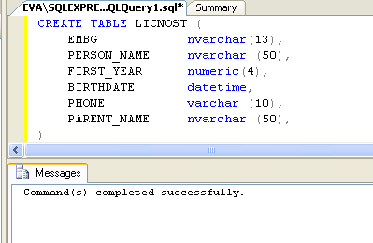
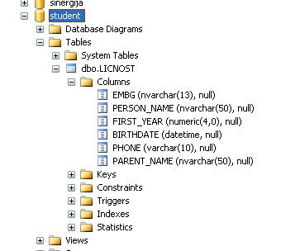
Result
refresh

Slide 13
Data types
The data type chosen for a column
determines the nature of the data that
can be stored in the column.
  Numeric data types.
  String or Character data types
  Date and/or time data types (DATETIME).

Slide 14
Numeric Data Type
  NUMERIC (p)
    Ex. Id_card numeric (5)
  FLOAT (s)
    Ex. Price FLOAT (2)

Slide 15
String Data Type
VARCHAR[(n)]: Variable-length
string values where n is the maximum
number of characters in the string
Ex. Code_Country VARCHAR(3)
NVARCHAR[(n)]: Variable-length
string values storing Unicode
characters.
Ex. name_Client NVARCHAR(50)

Slide 16
DROP TABLE
Permanent deletion of a table and it’s content.
Take care of integrity of data in the database
DROP table_name
  Ex. DROP Licnost

Slide 17
Constraints
NOT NULL
Ex.
CREATE TABLE Licnost
( P_Id numeric(5) NOT NULL,
Prezime varchar(255),
Ime varchar(255),
Adresa varchar(255),
Grad varchar(255) )

Slide 18
PRIMARY KEY
Ex.
CREATE TABLE Licnost
(P_Id numeric(5) NOT NULL PRIMARY KEY,
Prezime varchar(255),
Ime varchar(255),
Adresa varchar(255),
Grad varchar(255) )

Slide 19
DataBase Data
  Getting data from database:
  Ex.
  Select * from agenti
  Select ime, grad from agenti,gradovi where g_id_Grad=id_grad
  Select * from rabotnik1 left join odmor
  on r_id_rabotnk=id_rabotnik
  order by odmor

Slide 20
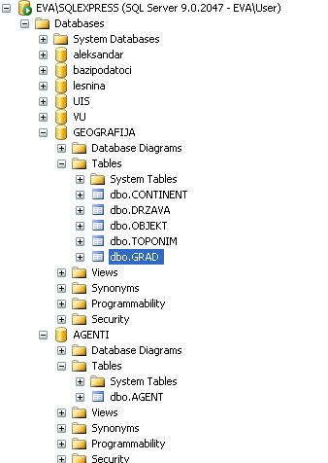
But...
  What if you need data that are located on two or more different databases, but on the same server?
Ex. Obtain data about city’s agents, ie table AGENT, database AGENTI. But the data about cities are in table GRAD in database GEOGRAFIJA

Slide 21
Access to objects in a databese
Method 1 :
[database].[schema].[object]
Method 2:
[server]. [database].[schema].[object]
(schema= DBO)

Slide 22
Example 1.
SELECT IME, PREZIME, GRAD.NAZIV
FROM [AGENTI].[DBO].AGENT AS AGENT,
[GEOGRAFIJA].[DBO].[GRAD] AS GRAD
WHERE GRAD.ID_GRAD=AGENT.ID_GRAD
ORDER BY GRAD.NAZIV

Slide 23
Example 2.
EVA\SQLEXPRESS is the name of the SQL 2005 Server
SELECT IME, PREZIME, GRAD.NAZIV
FROM
[EVA\SQLEXPRESS].[AGENTI].[DBO].AGENT AS AGENT,
[EVA\SQLEXPRESS].[GEOGRAFIJA].[DBO].[GRAD] AS GRAD
WHERE GRAD.ID_GRAD=AGENT.ID_GRAD
ORDER BY GRAD.NAZIV

Slide 24
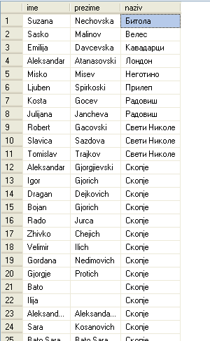
Example

Slide 25
Similarly you can make operations for addition, modification and deletion data
Ex.
UPDATE [EVA\SQLEXPRESS].[GEOGRAFIJA].[DBO].[GRAD] SET
NAZIV ='SKOPJE' WHERE NAZIV=‘СКОПЈЕ‘
INSERT INTO [EVA\SQLEXPRESS].[BAZIPODATOCI].[DBO].[ODMOR]
VALUES(5,24)
DELETE FROM [EVA\SQLEXPRESS].[BAZIPODATOCI].[DBO].[SP]

Slide 26
Data from databases from different versions of servers

Slide 27
Database server ...
Can have installed various types of RDBMS
  SQL 2000, 2005, 2008
  Oracle
  Db/2
  Etc.
  Sometimes there is need to combine data from different databases (or servers) on one computer

Slide 28
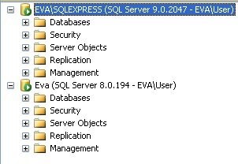
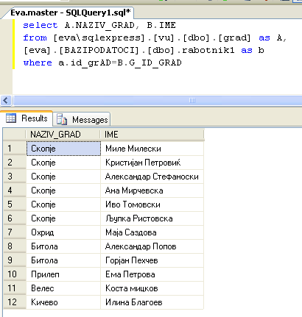
Working procedure
Establish a connection with all the servers (instances)
Establishing a procedure of creating SQL queries is the same

Slide 29
Data from databases from different physical servers

Slide 30
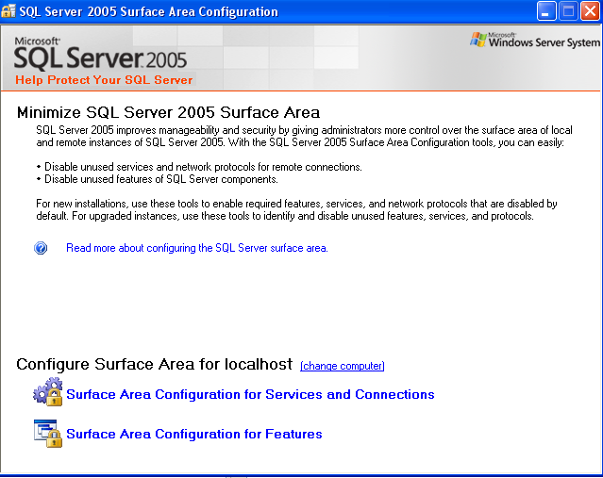
Enabling remote access to SQL Server 2005
Remote SQL Server 2005 server must have a permission to remote access

Slide 31
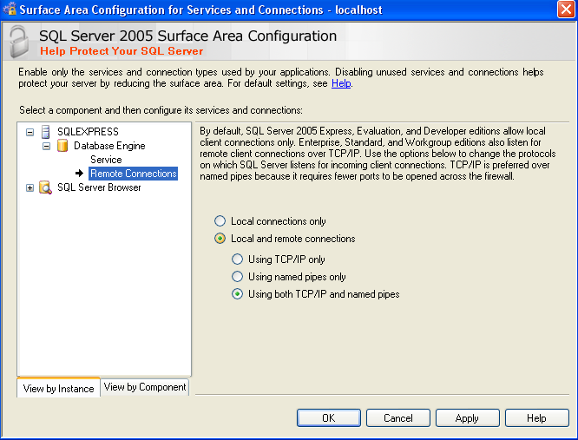
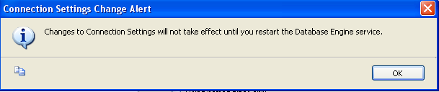
RESTART on service.

Slide 32
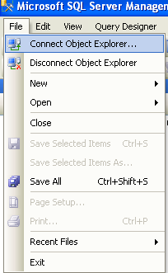
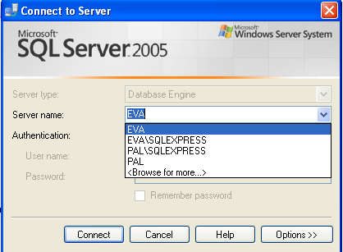
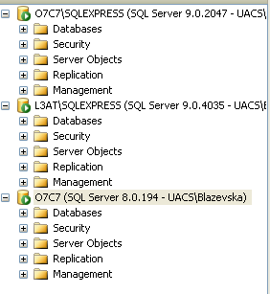
In SQL 2005
To be able to work with data from a server other than the current, you must connect to it.
Select the server and log into it. To find network server, used BROWSE FOR MORE..
Newly registered server is visible in the Object Inspector

Slide 33
Adding remote server in sysservers
In the local SQL Mng. Studio i.e. where you connect to the network server, execute procedure sp_addlinkedserver to add (register) server in the system table sysservers
еxec sp_addlinkedserver ‘L3AT\SQLExpress’
Overview on table sysservers (DB master)
select * from sysservers

Slide 34
Removing a server from sysservers table
SP_dropserver name_of_server
Ex.
SP_DROPSERVER ‘L3AT\SQLEXPRESS’
Warning !!!
Do not delete local SQL 2005 Server

Slide 35
An example of working with data from remote SQL 2005 server
SELECT *
FROM [L3AT\SQLEXPRESS].[BAZIPODATOCI].[DBO].[ODMOR]
2. SELECT *
FROM [L3AT\SQLEXPRESS].[BAZIPODATOCI].[DBO].[ODMOR] AS O,
[O7C7\SQLEXPRESS].[BAZIPODATOCI].[DBO].[RABOTNIK1] AS R
WHERE O.R_ID_RABOTNIK=R.ID_RABOTNIK

Slide 36
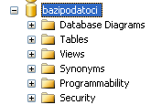
Logical Tables - VIEW
Virtual, logical tables (views) are data components whose content is generated at the time of their calling
It can be used in SELECT statements just like ordinary tables.
Syntax:
CREATE VIEW name AS select expression
ALTER Command is not used for logical tables (view).

Slide 37
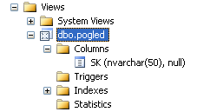
Example: view
CREATE VIEW pogled
AS
SELECT SP.SK
FROM S, SP
WHERE S.SK =SP.SK

Slide 38
Using views
SELECT * FROM POGLED
SELECT * FROM POGLED WHERE SK=‘S1’
-SELECT COUNT(*) FROM POGLED
-SELECT SK, A_NAME, LEVEL
FROM POGLED,AGENT WHERE LEVEL=1 AND SK=‘S2’

Slide 39
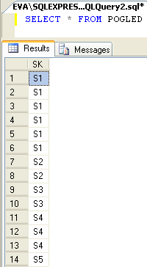
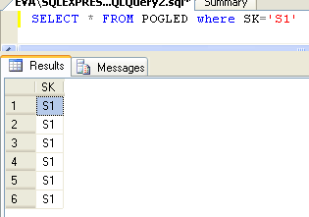
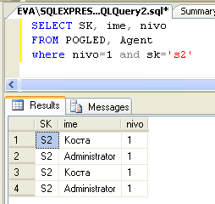
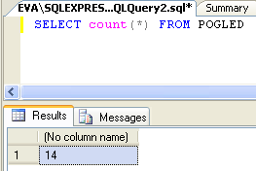
Using views

Slide 40
Assignment 4
Create views
  Calculate the average age of the workforce and number of workers grouped according to hours of operation(homework)
  List of product categories (PC_komponenti)
  List all the data for workers and rest days(0)
  List the name of a student and school

Slide 41
Assignment 5
Show the work of views
  Call the view table 1
  Count how many categories are in 2

Slide 42
System tables
When creating SQL object, you create Metadata for the same. These metadata are saved in system tables.
  If you create a new column, then information about its name, type, table of belonging and so on.are Stored in system table named syscolumns.
  All supported tupes of data are in systypes
System tables are hidden objects in SQL 2005 (which is not the case with previous versions of SQL Server), but the same are a part of the system procedures and views

Slide 43
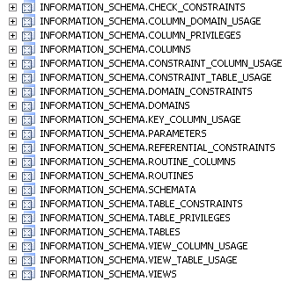
INFORMATION_SCHEMA
Group of systemic views in a DB
  There are 20 different views that represent the most needed information for the database, ex. its tables, columns, views, procedures, etc.
Ex.
  Tables
  Columns
  Views
  Table_constraints
  Routines

Slide 44
Catalog views - SYS
Group with a huge number of views
Many od the columns that are a part of these view are self-describing
  More subgroups of views
    The views that give as information about tables, constraints, columns, triggers, indexs, and so on are part of a group called "Objects Catalog Views“.
      Sys.tables, sys.columns …
    "Sys All“- 4 views that contain information about all objects in database system and user created
      sys.all_columns, sys.all_objects, sys.all_parameters, and sys.all_views.

Slide 45
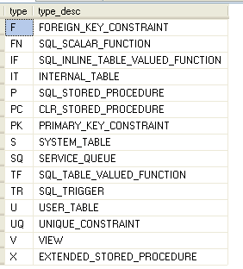
Example
select distinct type, type_desc from sys.all_objects order by type

Slide 46
Example. 2
SELECT C.NAME AS C_COLUMN, T.NAME AS C_TABLE
FROM SYS.COLUMNS AS C, SYS.TABLES AS T
WHERE C.OBJECT_ID=T.OBJECT_ID
What we got as a result?

Slide 47
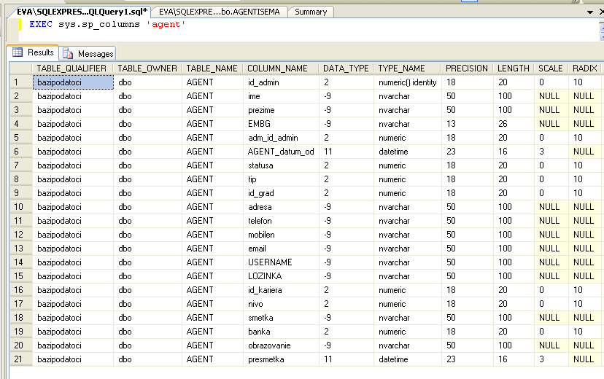
System procedures
There are many system procedures that are used for administrative purposes. They return similar results as the system views
  EXEC sys.sp_columns ‘Agent'

Slide 48
Legacy from SQL 2000 – System tables
SYSOBJECTS – objects in a database
SYSCOLUMNS – columns on a database
SYSFILES – physical path to database files
SYSUSERS - overview of the users in a database
SYSTYPES - supported data types

Slide 49
Assignment 6 (bazipodatoci)
Create SQL queries (or perform the appropriate procedure), analyze the results and discover the most important columns could you use
    INFORMATION_SCHEMA.COLUMNS
    INFORMATION_SCHEMA.TABLES
    INFORMATION_SCHEMA.ROUTINES
    INFORMATION_SCHEMA.VIEWS
    INFORMATION_SCHEMA.TABLE_CONSTRAINTS
    sys.all_columns
    sys.all_objects
    sys.sysdatabases – (master)

Slide 50
(cont.)
    Sys.columns
    Sys.Objects
    sys.procedures -
    sys.sysservers -
    Sys.sysusers -
    sys.tables
    sys.triggers
    sys.types
    sys.sp_columns
    sys.sp_databases (master)
    Sys.sp_tables
    Sys.sp_who
    Sysfiles

